Slide 1
AREAS IN POLAR COORDINATES

Slide 2
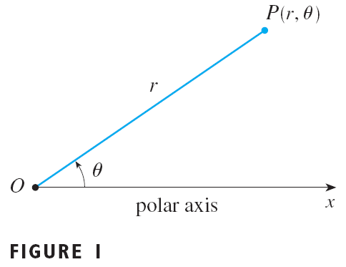
POLAR COORDINATES
If P is any other point in the plane, let:
r be the distance from O to P.
θ be the angle (usually measured in radians) between the polar axis and the line OP.
P is represented by the ordered pair (r, θ).
r, θ are called polar coordinates of P.
We use the convention that an angle is:
Positive—if measured in the counterclockwise direction from the polar axis.
Negative—if measured in the clockwise direction from the polar axis.
If P = O, then r = 0, and we agree that (0,θ) represents the pole for any value of θ.

Slide 3
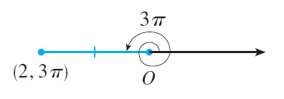
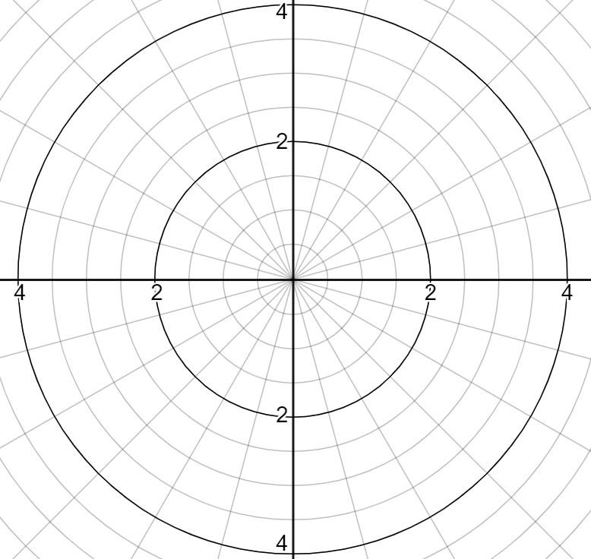
Examples
Plot the points whose polar
coordinates are given.
(1, 5π /4)
(2, 3π)
(2, –2π /3)
(–3, 3π /4)

Slide 4
CARTESIAN & POLAR COORDINATES

Slide 5
Examples
Convert some points from Polar coordinates to Cartesian coordinates and conversely:
Polar coordinate | Cartesian coordinate
(2, π/3)
 | (1, –1)

Slide 6
Exercies: Polar Coordinates
Ex 1. Plot the points whose polar coordinates are given and find the corresponding Cartesian coordinate
Ex 2. Convert some points from Cartesian coordinates to Polar coordinates:
 | Polar coordinate | Cartesian coordinate
A | (3,0)
B | (2,π/2)
C | (-2, π)
D | (3, -2π/3)
E | (3, 3π /4)
F | (2, –5π /6)
G | (-2, -π /4)
 | Polar coordinate | Cartesian coordinate
M
N
P
Q

Slide 7
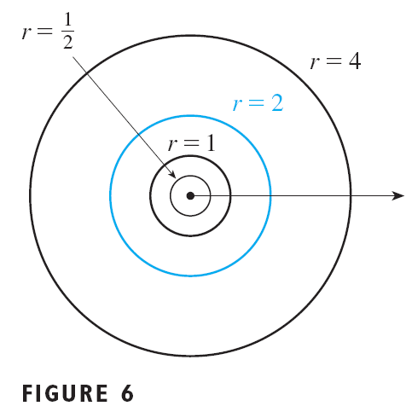
POLAR CURVES
The graph of a polar equation r = f(θ) [or, more generally, F(r, θ) = 0] consists of all points that have at least one polar representation (r, θ), whose coordinates satisfy the equation.

Slide 8
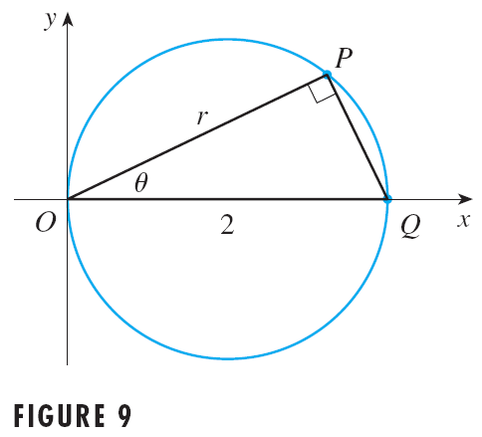
POLAR CURVES
Sketch the curve with polar equation r = 2 cos θ.

Slide 9
POLAR CURVES
Sketch the curve r = 1 + sin θ.

Slide 10
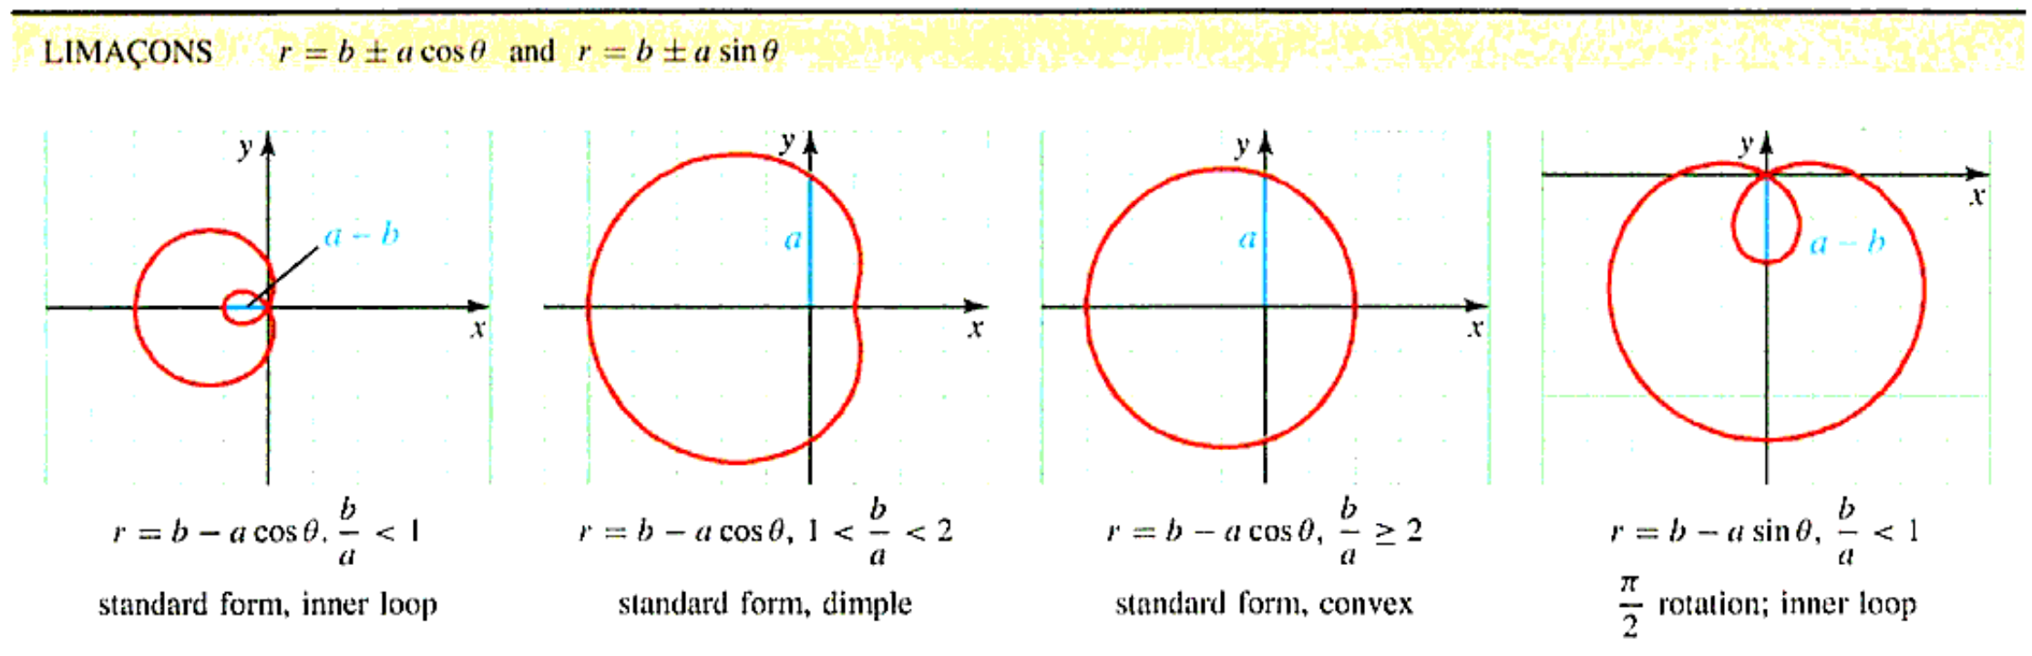
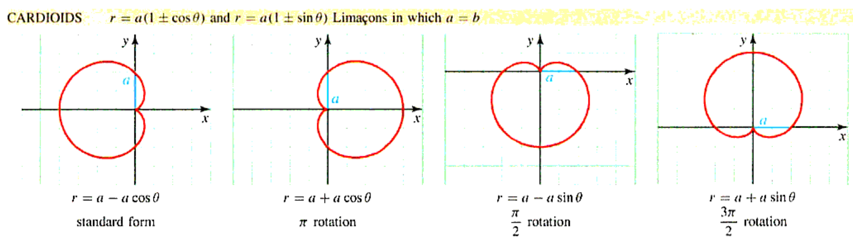
POLAR CURVES (Table 6.2)

Slide 11
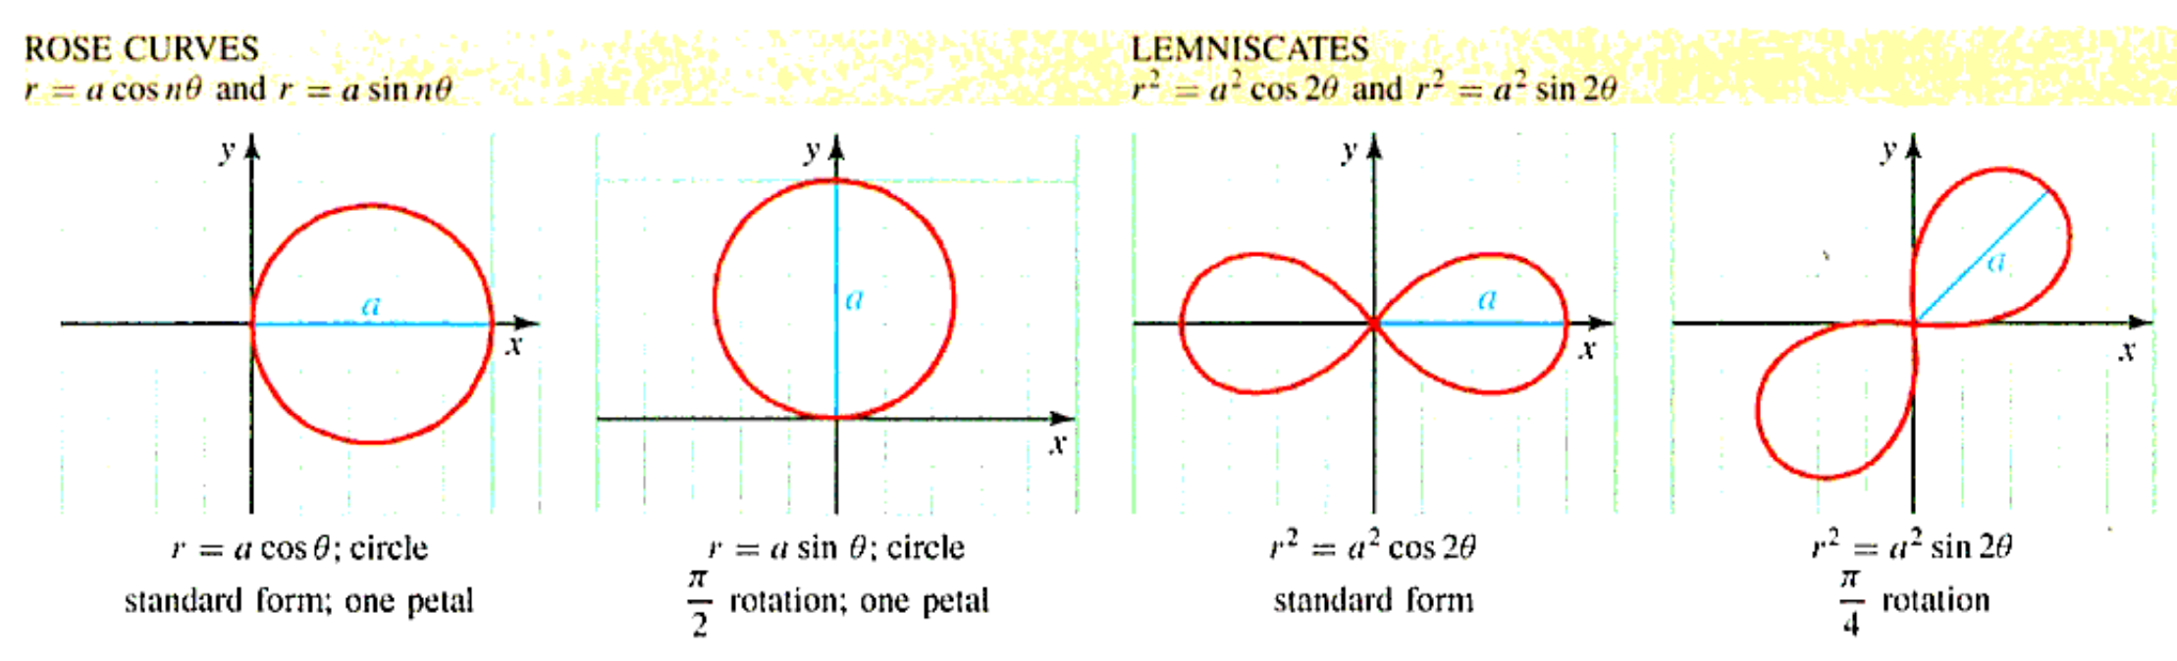
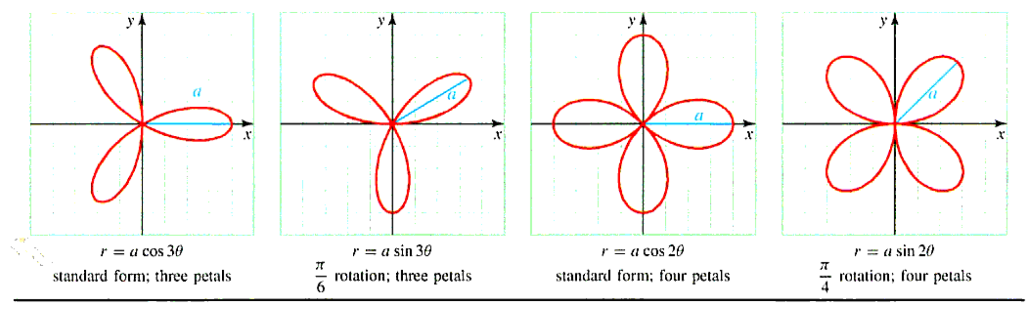
POLAR CURVES (Table 6.2)

Slide 12
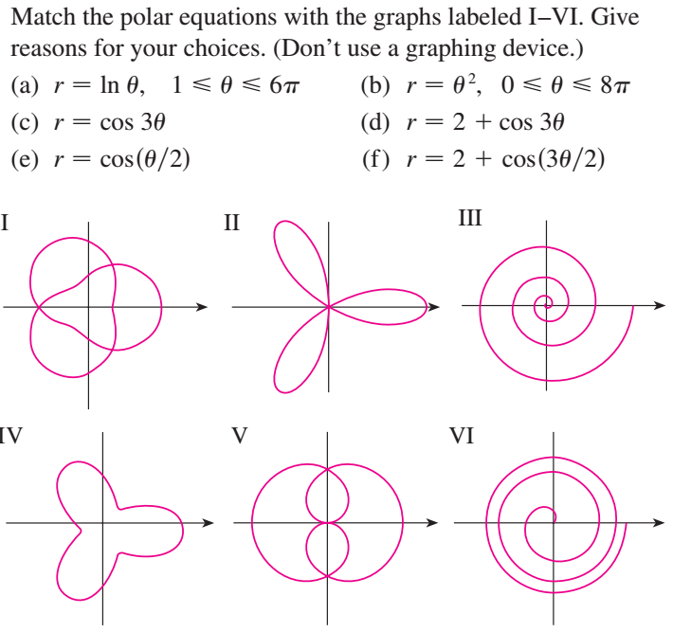
Exercises: Curves in Polar Coordinates
Ex 1.
Ex 2.
Sketch the curve with the given polar equation:
r = 3 sin θ
r = 2 - 2 sin θ
r = 2 cos 4θ
r² = 9 sin 2θ
r = 1 + 5 cos θ

Slide 13
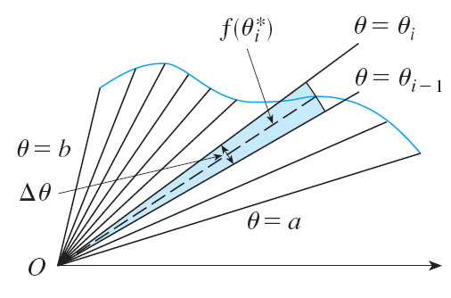
AREAS IN POLAR COORDINATES
A = (θ /2π)πr² = ½r² θ
∆A_{i} ≈ ½[f(θ _{i}*)]² ∆ θ

Slide 14
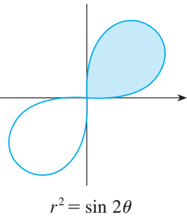
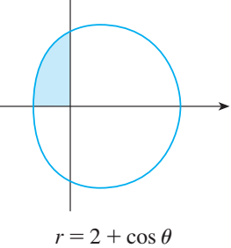
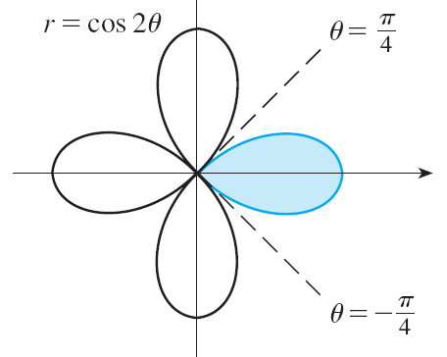
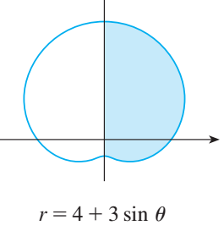
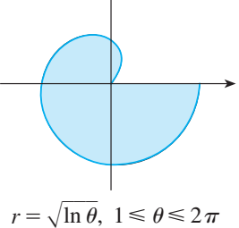
Examples
Find the area enclosed by one
loop of the four-leaved rose r = cos 2θ.
Find the area of the shaded region

Slide 15
AREAS IN POLAR COORDINATES
Let R be a region, as illustrated in Figure 6, that is bounded by curves with polar equations
r = f(θ), r = g(θ), θ = a, θ = b,
where f(θ) ≥ g(θ) ≥ 0, 0 < b – a < 2π

Slide 16
Examples
Find the area of the region that lies inside the circle r = 3 sinθ and outside the cardioid r = 1 + sinθ.
They intersect when
3sin θ = 1 + sin θ,
which gives sin θ = ½. So,
θ = π/6 and 5π/6

Slide 17
Exercises: Areas in Polar Coordinates
Ex 1. Find the area of the region that lies inside the frst curve and outside the second curve.
r = 4 sin θ, r = 2
r = 1 - sin θ, r = 1
r = 1 + cos θ, r = 2 - cos θ
r = 3 cos θ, r = 1+cos θ
Ex 2. Find the area of the region that lies inside both curves.
r = 3 sinθ, r = 3 cosθ
r = 3 +2 cosθ, r = 3 +2 sinθ
r² = 2 sin 2θ, r = 1

